Slide 1

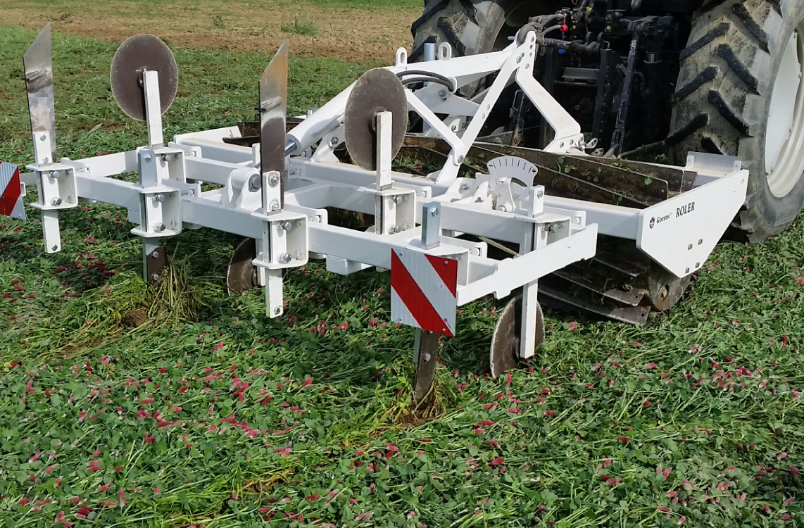
Prof. Dr. Martina Bavec, viš. pred. mag. M. Jakop, viš. pred. mag. M. Robačer, prof.dr. F. Bavec
Primeri predlogov za novo SKP:
Prekrivni posevki in uporaba valjarja rastlinske odeje

Slide 2
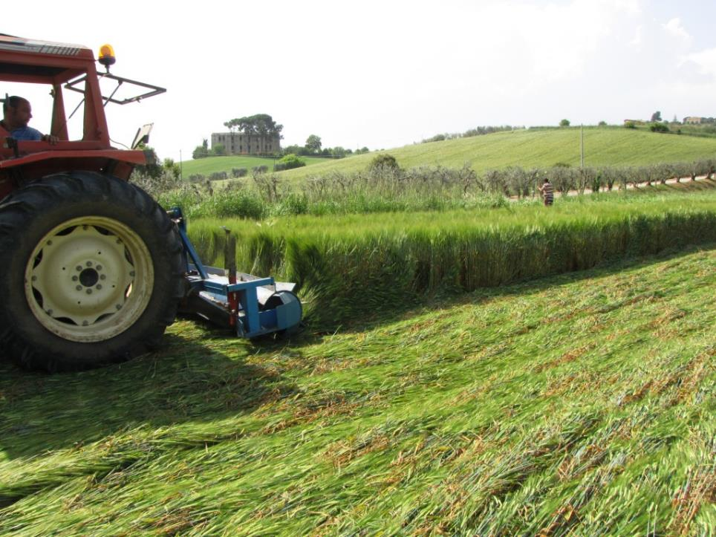

COVER CROPS
Weed management
Beneficial insects
In -Field biodiversity
Nutrients availabity
Uvod
Prednosti
Rezultati
4. Predlog
Cover crops are, in organic systems, a link between soil, crop, pest and weed management (Barberi, 2002)

Slide 3
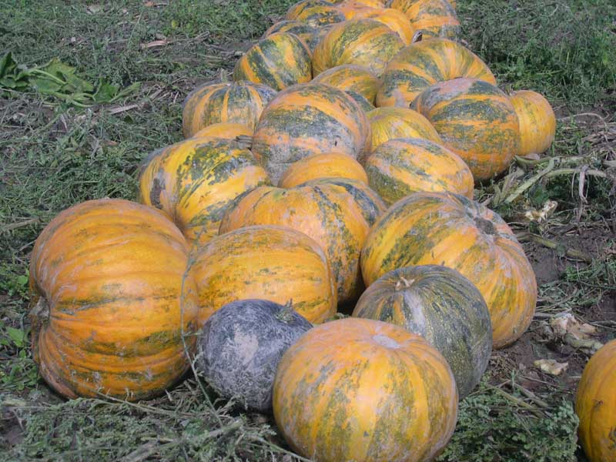
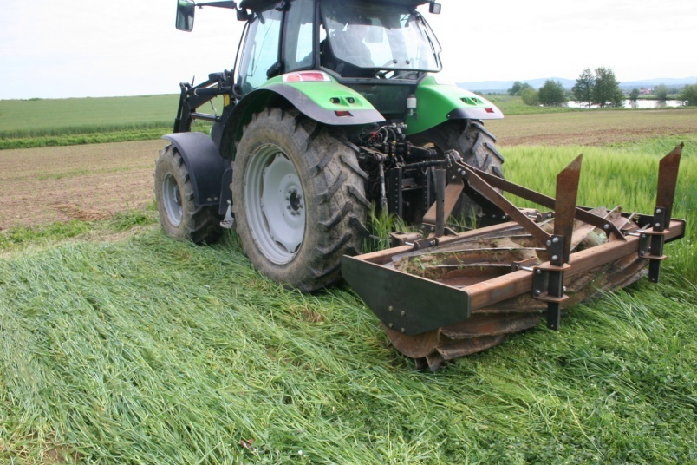
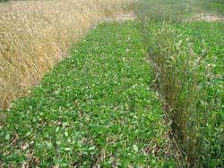
Valjar
  Soja in umgewalztem Roggen in einer Versuchsparzelle © Naturland, W. Vogt-Kaute
Soja in umgewalztem Roggen in einer Versuchsparzelle © Naturland, W. Vogt-Kaute
http://sojainfo.de/soja_infos_direktsaat_usa.html

Slide 5
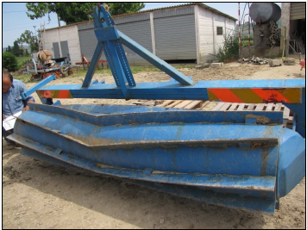
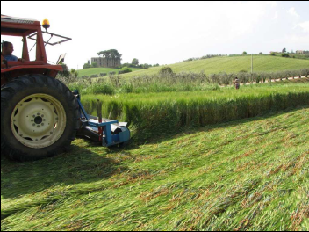
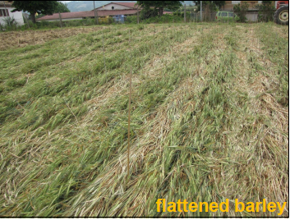

Photos
Canali S., ISOFAR conf. 2011

Slide 6
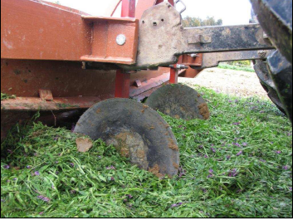
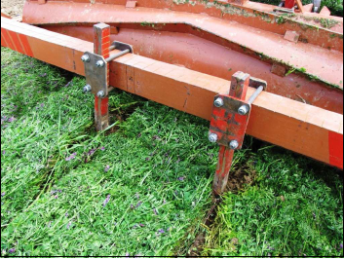
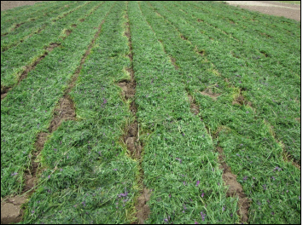
Vprašanja ?
Photos:
Canali S., ISOFAR conf. 2011

Slide 7
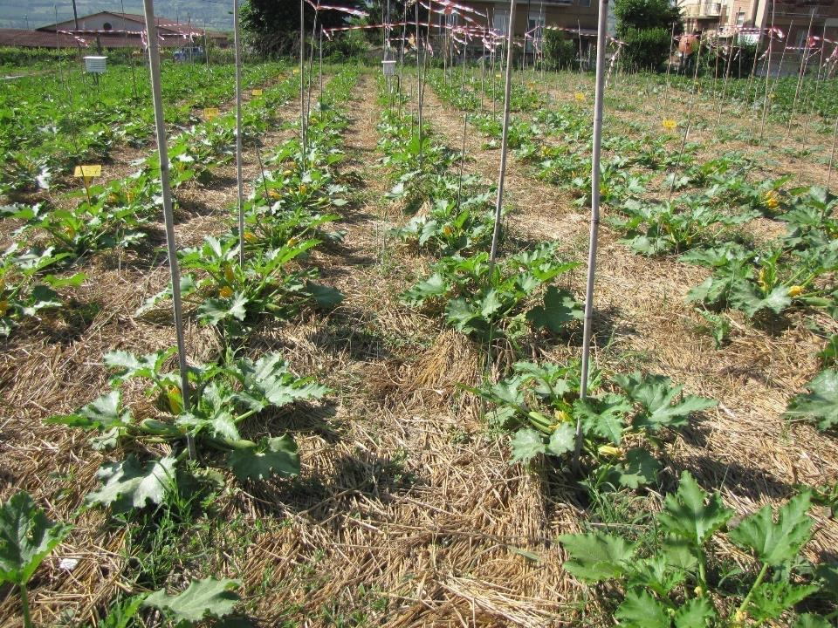


Slide 8
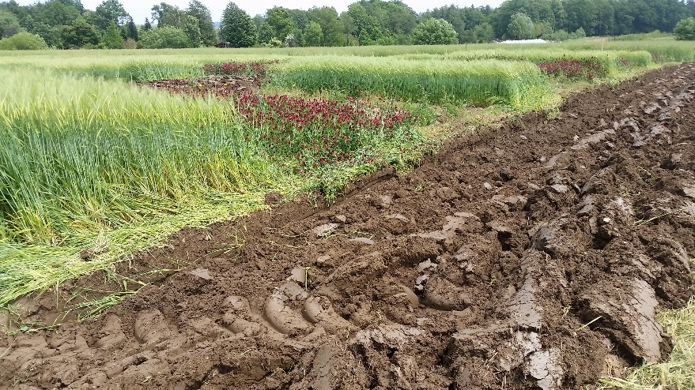
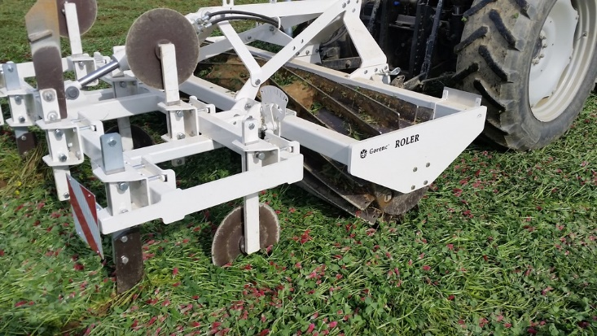
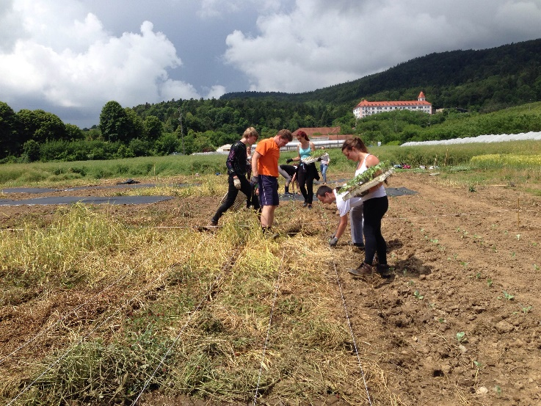
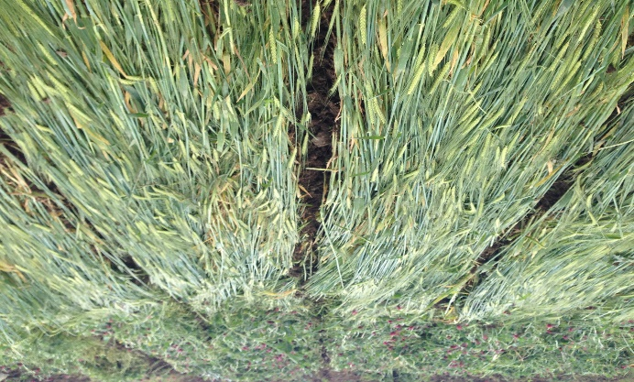
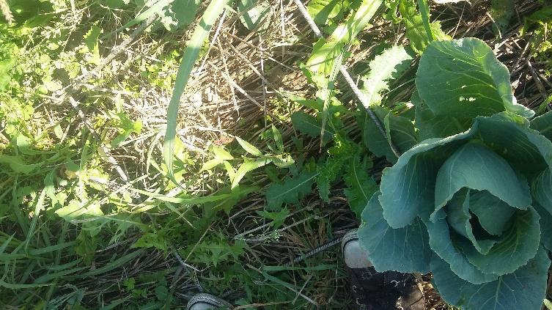
SOILVEG - Frrom WP 3.1 - Soil fertility and WP 7 - Short term agro-ecosystem N dynamics,
NO₃ - leaching assessment and root growth
Interim Report, 2016, partner: UM (Bavec M. ,…)
The loamy soil, low pH (pH H₂O = 5,98 and 2.2% of organic matter.

Slide 9
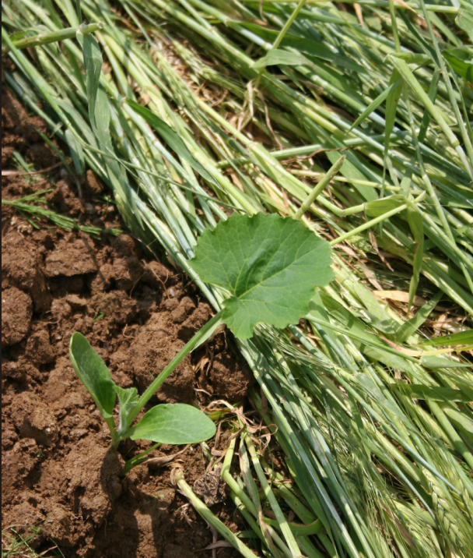
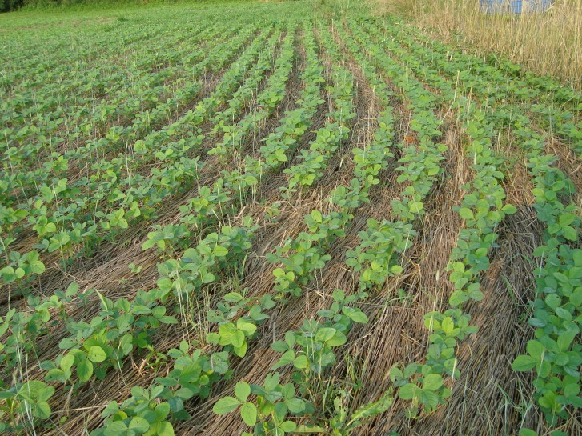
Francis Thicke used a culti-packer to roll his cereal rye cover crop ahead of soybeans. This photo was taken on July 2, 2015 near Fairfield.
http://www.practicalfarmers.org/blog/2016/03/17/rolling-cover-crops/

Slide 10
Projekti: INTERVEG - Enhancing multifunctional benefits of cover crops − vegetables intercropping
(2011 – 2015)
SOILVEG -Improving soil conservation and resource use in organic cropping systems for vegetable production
V prijavi 2019: Uvedba novih tehnik ohranitvene obdelave z valjarjem rastlinske odeje za prilagoditev pridelovalnim razmeram in klimatskin spremembam (ARRS-RPROJ-JR-Prijava/2018-II/386)
Scientia Horticulturae, 2016: Cover crops in organic field vegetable production (IF: 1,954 v letu 2017); ROBAČER, Martina, CANALI, Stefano, LAKKENBORG KRISTENSEN, Hanne, BAVEC, Franc, GROBELNIK MLAKAR, Silva, JAKOP, Manfred, BAVEC, Martina. Cover crops in organic field vegetable production. Scientia horticulturae, ISSN 0304-4238. [Print ed.], 2016, vol. 208, str. 104-110
Renewable Agriculture and Food Systems, 2017: Yield, product quality and energy use in organic vegetable living mulch cropping systems: research evidence and farmers’ perception (IF 1,701 v letu 2017);CANALI, Stefano, ORTOLANI, Livia, CAMPANELLI, G., ROBAČER, Martina, FRAGSTEIN, Peter von, D'OPPIDO, D., KRISTENSEN, Hanne L. Yield, product quality and energy use in organic vegetable living mulch cropping systems : research evidence and farmers' perception. Renewable agriculture and food systems, ISSN 1742-1705, June 2017, vol. 32, iss. 3, str. 200-213.
Renewable Agriculture and Food Systems, 2017: Impact of living mulch on arthropod fauna: analysis of pest and beneficial dynamics on organic cauliflower (Brassica oleracea L. var. botrytis) in different European scenarios (IF 1,701 v letu 2017).DEPALO, L., BURGIO, G., FRAGSTEIN, Peter von, KRISTENSEN, Hanne L., BAVEC, Martina, ROBAČER, Martina, CAMPANELLI, G., CANALI, Stefano. Impact of living mulch on arthropod fauna: analysis of pest and beneficial dynamics on organic cauliflower (Brassica oleracea L. var. botrytis) in different European scenarios. Renewable agriculture and food systems, ISSN 1742-1705, June 2017, vol. 32, special Iss. 3, str. 240-247.
M. Robačer, 2019: : Agronomski in okoljski vidiki prekrivnih posevkov v ekološki pridelavi zelenjadnic / Agronomic and Environmental Aspects of Cover Crops in Organic Vegetable Production. Doktorska disertacija. UM, 105 s., 21 preg., 6 grafik., 178 ref.
XIE, Yue, TITTARELLI, Fabio, FRAGSTEIN, Peter von, BAVEC, Martina, CANALI, Stefano, LAKKENBORG KRISTENSEN, Hanne. Can living mulches in intercropping systems reduce the potential nitrate leaching? Studies of organic cauliflower (Brassica oleracea L. var. botrytis) and leek (Allium porrum L.) production across European conditions. Renewable agriculture and food systems, ISSN 1742-1705, June 2017, vol. 32, special Iss. 3, str. 224-239.

Slide 11
Predstavitve
JAKOP, Manfred, BAVEC, Martina, ROBAČER, Martina, GROBELNIK MLAKAR, Silva, VUKMANIČ, Tjaša, LISEC, Urška, BAVEC, Franc. Valjar rastlinske odeje za slovenske talne in klimatske razmere. Kmetovalec : strokovna kmetijska revija, ISSN 1318-4245., december 2017, letn. 85, št. 12, str. 28-30
Predstavljeno na več slovenskih posvetih in demonstarcijah ter izobraževanju za kmet. svetovalce
BAVEC, Martina, ROBAČER, Martina, LISEC, Urška, VUKMANIČ, Tjaša, JAKOP, Manfred, GROBELNIK MLAKAR, Silva, BAVEC, Franc, CANALI, Stefano. Using cover crops for increasing biodiversity and maintaining soil fertility in organic vegetable production. V: MANOJLOVIČ, Maja (ur.). Book of abstracts, 3rd International Conference Agrobiodiversity "organic Agriculture for Agrobiodiversity Preservation", Novi Sad, 1st - 3rd June 2017. Novi Sad: Faculty of Agriculture. 2017, str. 86. [COBISS.SI-ID 4332588] BAVEC, Martina, ROBAČER,
Martina, BAVEC, Franc, VUKMANIČ, Tjaša, JAKOP, Manfred, LISEC, Urška, GROBELNIK MLAKAR, Silva, CANALI, Stefano. SoilVeg - Improving soil conservation and resource use in organic cropping systems for vegetable production throuhg introduction and management of Agro-ecological Service Crops. V: BAVEC, Martina (ur.), BAVEC, Franc (ur.), GROBELNIK MLAKAR, Silva (ur.). Book of abstracts, VII South-Eastern Europe Symposium on Vegetables & Potatoes, June 20 - 23, 2017, Maribor, Slovenia. Maribor: University of Maribor Press; Pivola: Faculty of Agriculture and Life Sciences. 2017

Slide 12
Predlog -
Najmanj 20% njivskih površin (npr. kolobarja v 5. letih) v sistemu setev oz. sajenj v povaljan posevek.
Zahteva: Namensko posejan posevek rastlin(e). Izbor rastline in rastna sezona morata omogočiti vsaj 8 cm debelo povaljano odejo, ki v neposejanih/posajenih vrstah popolnoma prekrije tla.

