Slide 1

Primeri predlogov za novo SKP:
Njivski kolobar za povečanje biodiverzitete (združene setve in alternativne njivske rastline)
Prof. dr. Franc Bavec
Aktualno na področju ekološkega kmetijstva, 25.01.2019

Slide 2
Source:
Underutilized Crops and Intercrops in Crop Rotation as Factors for Increasing Biodiversity on Fields
By Franc Bavec and Martina Bavec
In: Biodiversity in Ecosystems - Linking Structure and Function", Ed. Yueh-Hsin Lo, Juan A. Blanco and Shovonlal Roy, ISBN 978-953-51-2028-5, INTECH, April 17, 2015
Figure 1. Comparison of negative effects of monoculture and positive effects of crop rotation, alternative crops and intercrops on biodiversity parameters

Slide 3
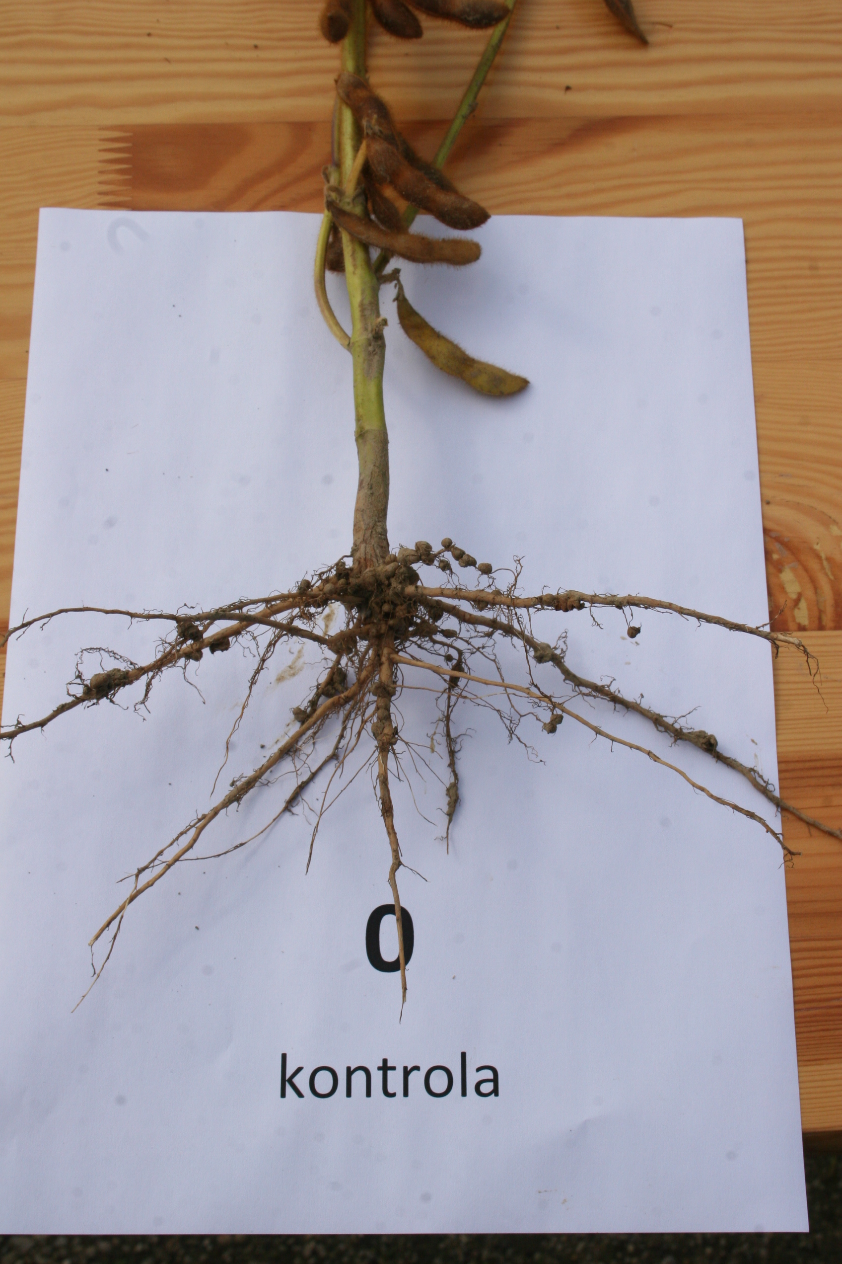
Združene setve (Intercropping)
Gre za združevanje dveh ali več rastlinskih vrst na isti njivi, pri čemer rastejo skupaj vsaj en del rastne dobe. Prednosti združenih posevkov so lahko naslednje: večja biodiverziteta kultiviranih rastlin, večja biotska pestrost v tleh, simbiotska fiksacija dušika če združujemo posevke z leguminozami, večje biološko ravnotežje v primeru škodljivcev in bolezni ter posledično stabilnejši pridelki, povečana konkurenčnost plevelom, večja biološka pestrost živinske krme, pri čemer se odločamo za združevanje posevkov, ki omogoča večjo izkoristljivost prostora in klimatskih dejavnikov kot pridelava samostojnih posevkov (LER).

Slide 4
Nekaj rezultatov s FKBV
Združene setve koruza in visoki fižol, rž in pšenica, krmni grah in ječmen, koruza in zrnati ščiri (CRP: Intercropping - alternativa za zmanjšanje inputov v pridelavi zelenjave in poljščin, 2006 – 2009).
(koruza + fižol: LER večji od 1, oplemeniten pridelek,….)
Združevanje belega zelja + glavnata solata, z. + nizki fižol, z. + rdeča pesa, z. + paradižnik, z. + por ( Skupni pridelek višji kot v samostojnem nasadu/posevku – vrednosti LER pri vse večje od 1, do 1.45 (Žuljan, mag. delo, 2009).
Pridelek poljščin in zelenjadnic v odvisnosti od kolobarja v različnih pridelovalnih sistemih, (Setinšek, mag. delo, FKBV, 2019).

Slide 5
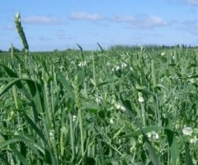
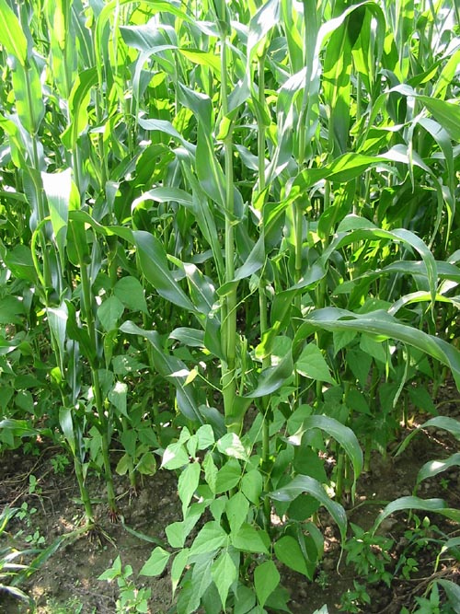

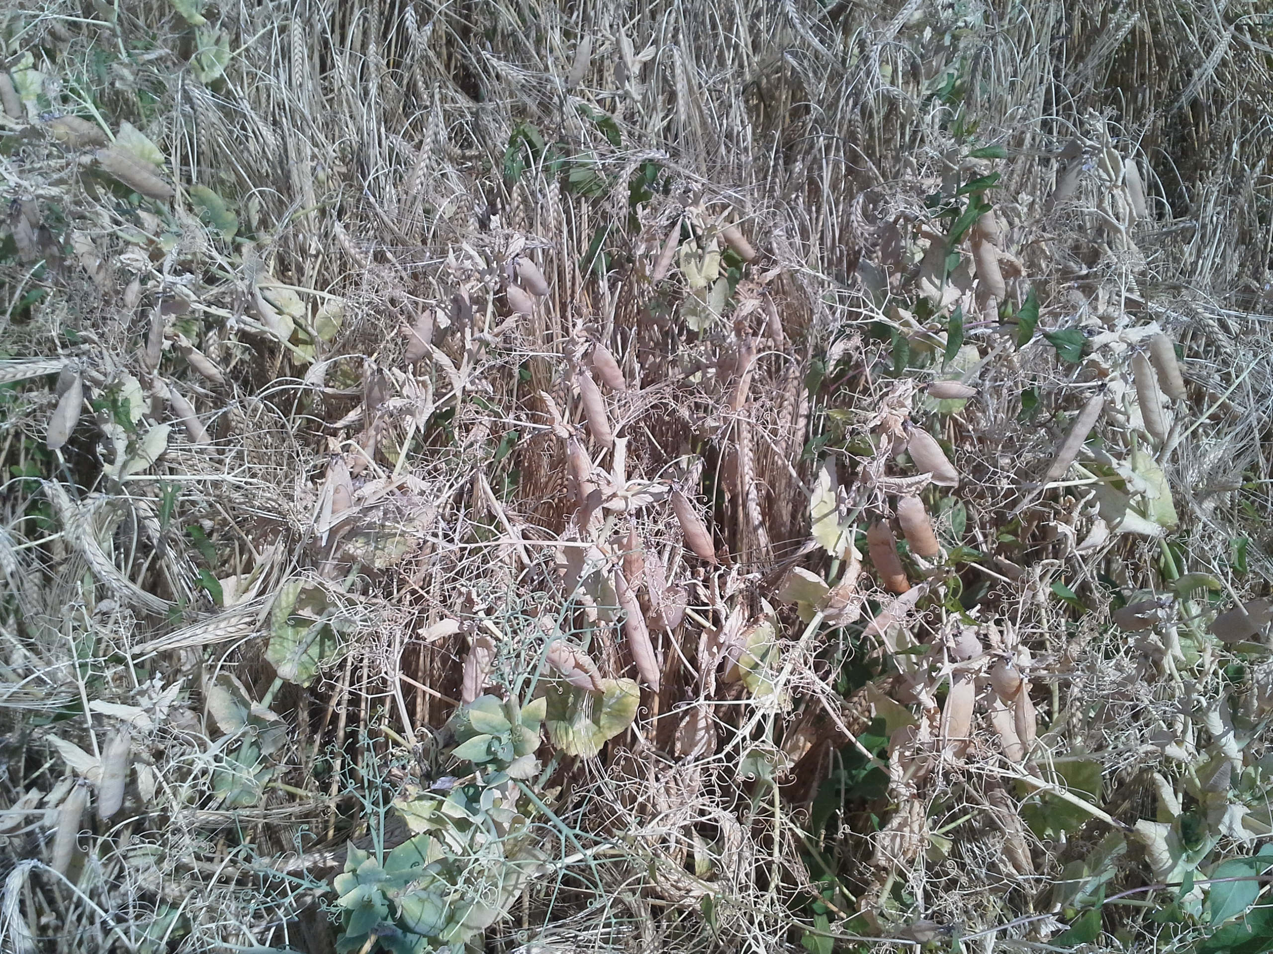
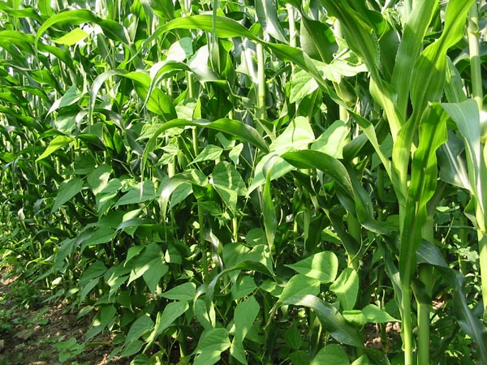
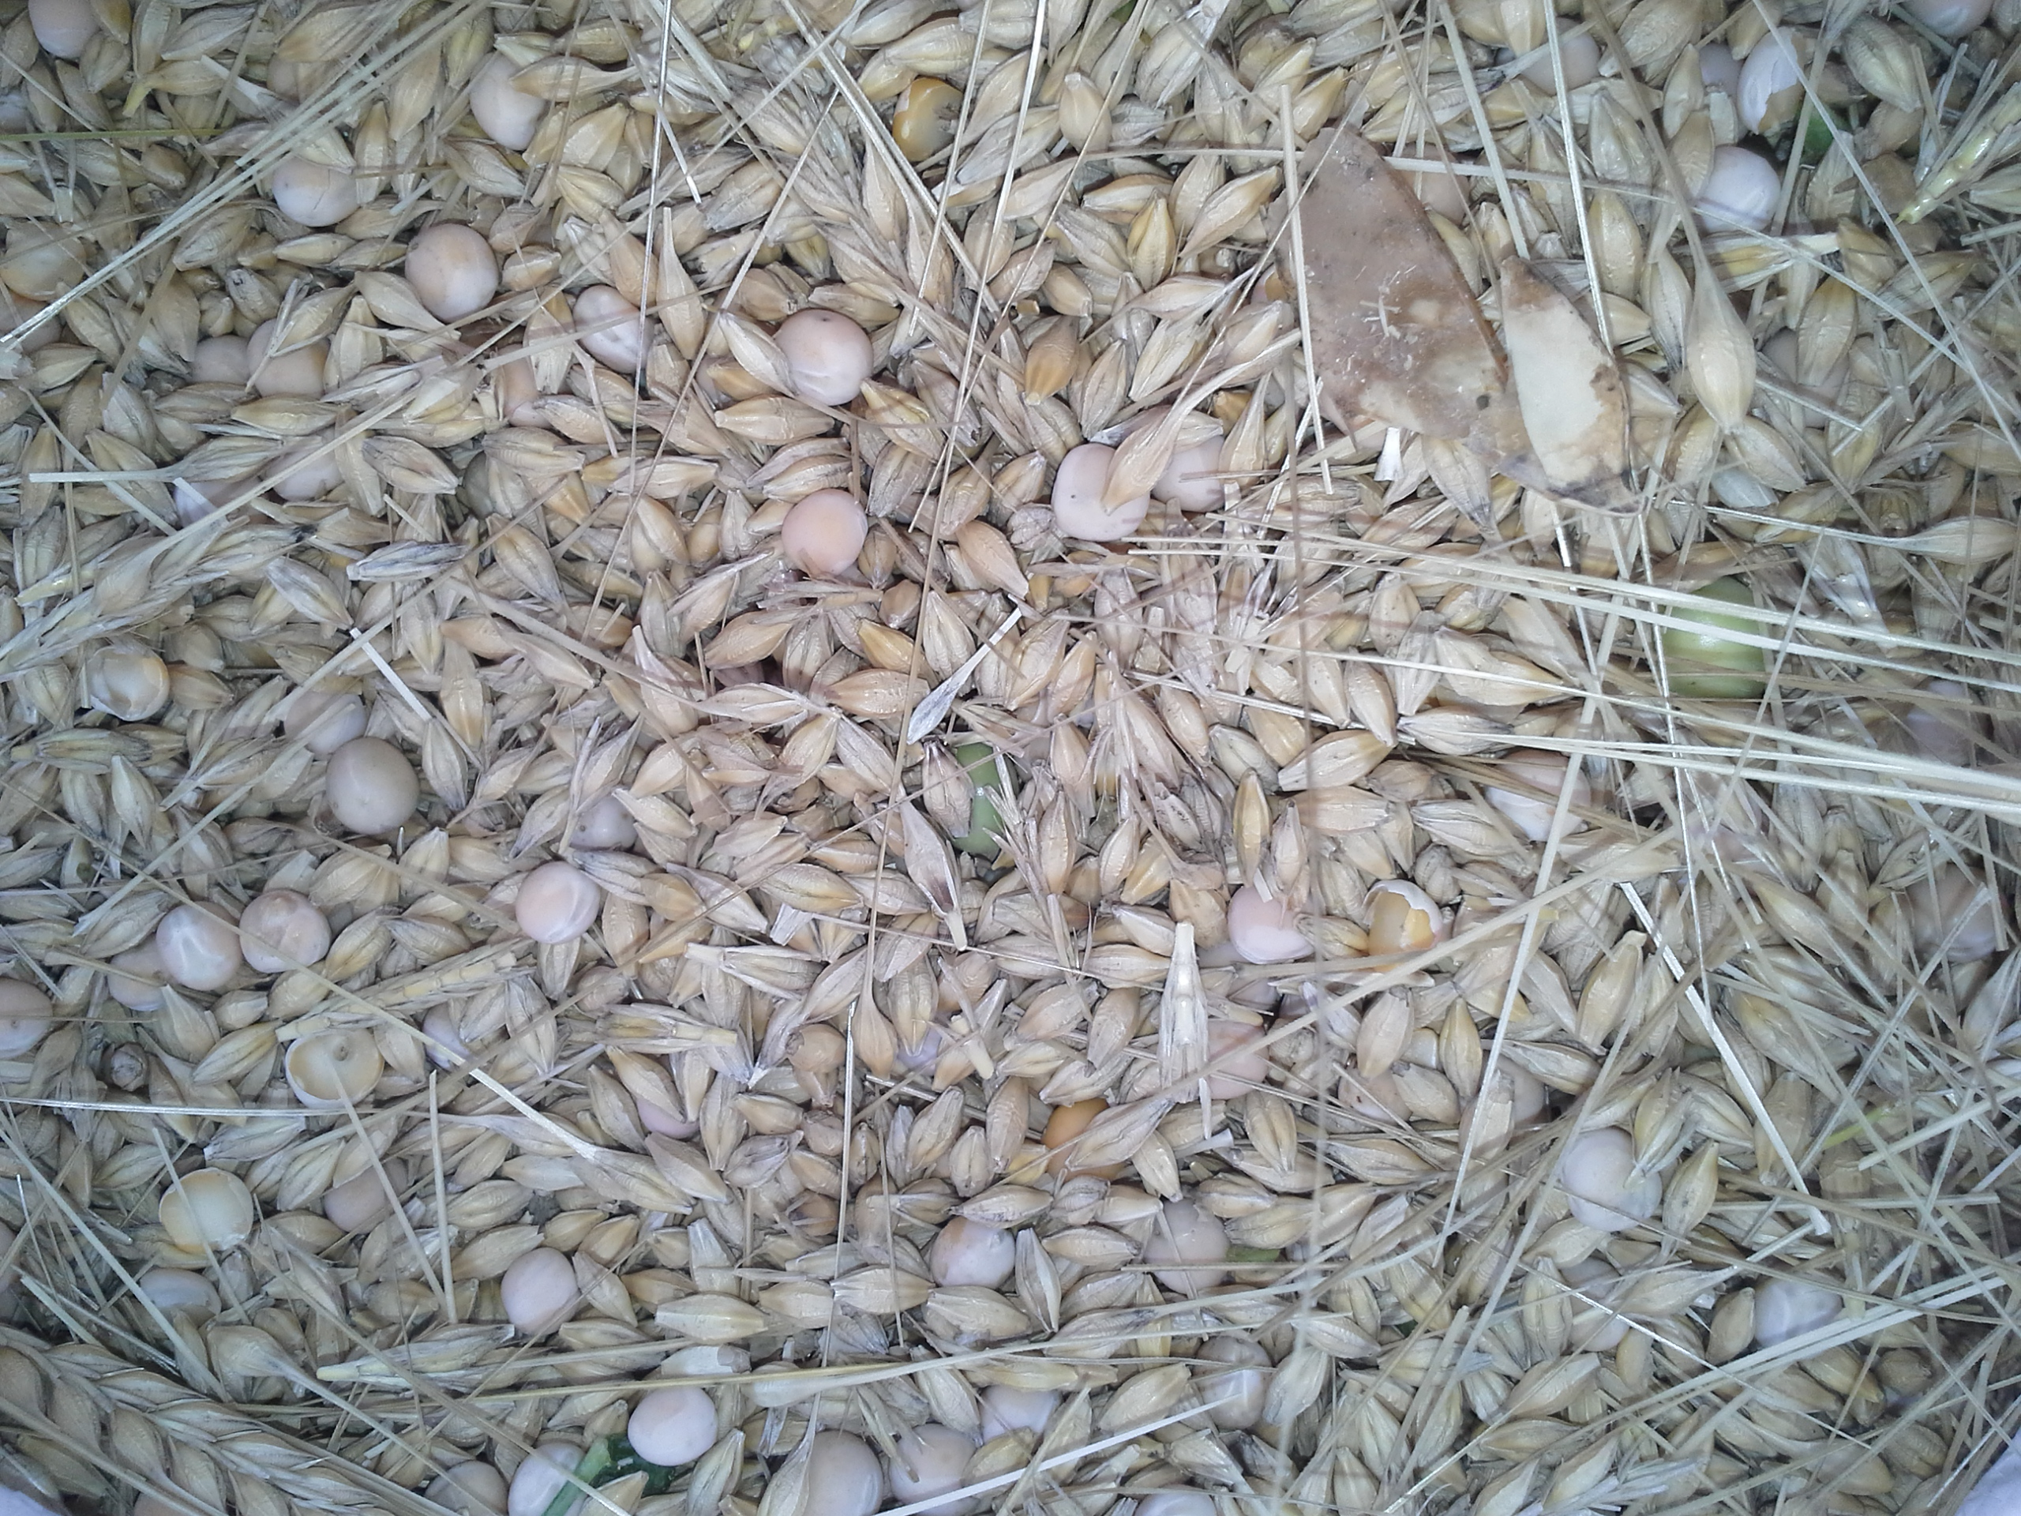
Združena setev – grah + žita koruza + fižol …

Slide 6
TD-O_09 Needs for production of grain protein crops in Europe and possibilities for more bio-based green economy including nitrogen use
Bavec, F.; Bavec, S.; Grobelnik, S.; Jakop, M.; Robacer, M.; Rozman, Č.; Bavec, M.
RAMIRAN 2015 – 16th International Conference Rural-Urban Symbiosis, Hamburg

Slide 7
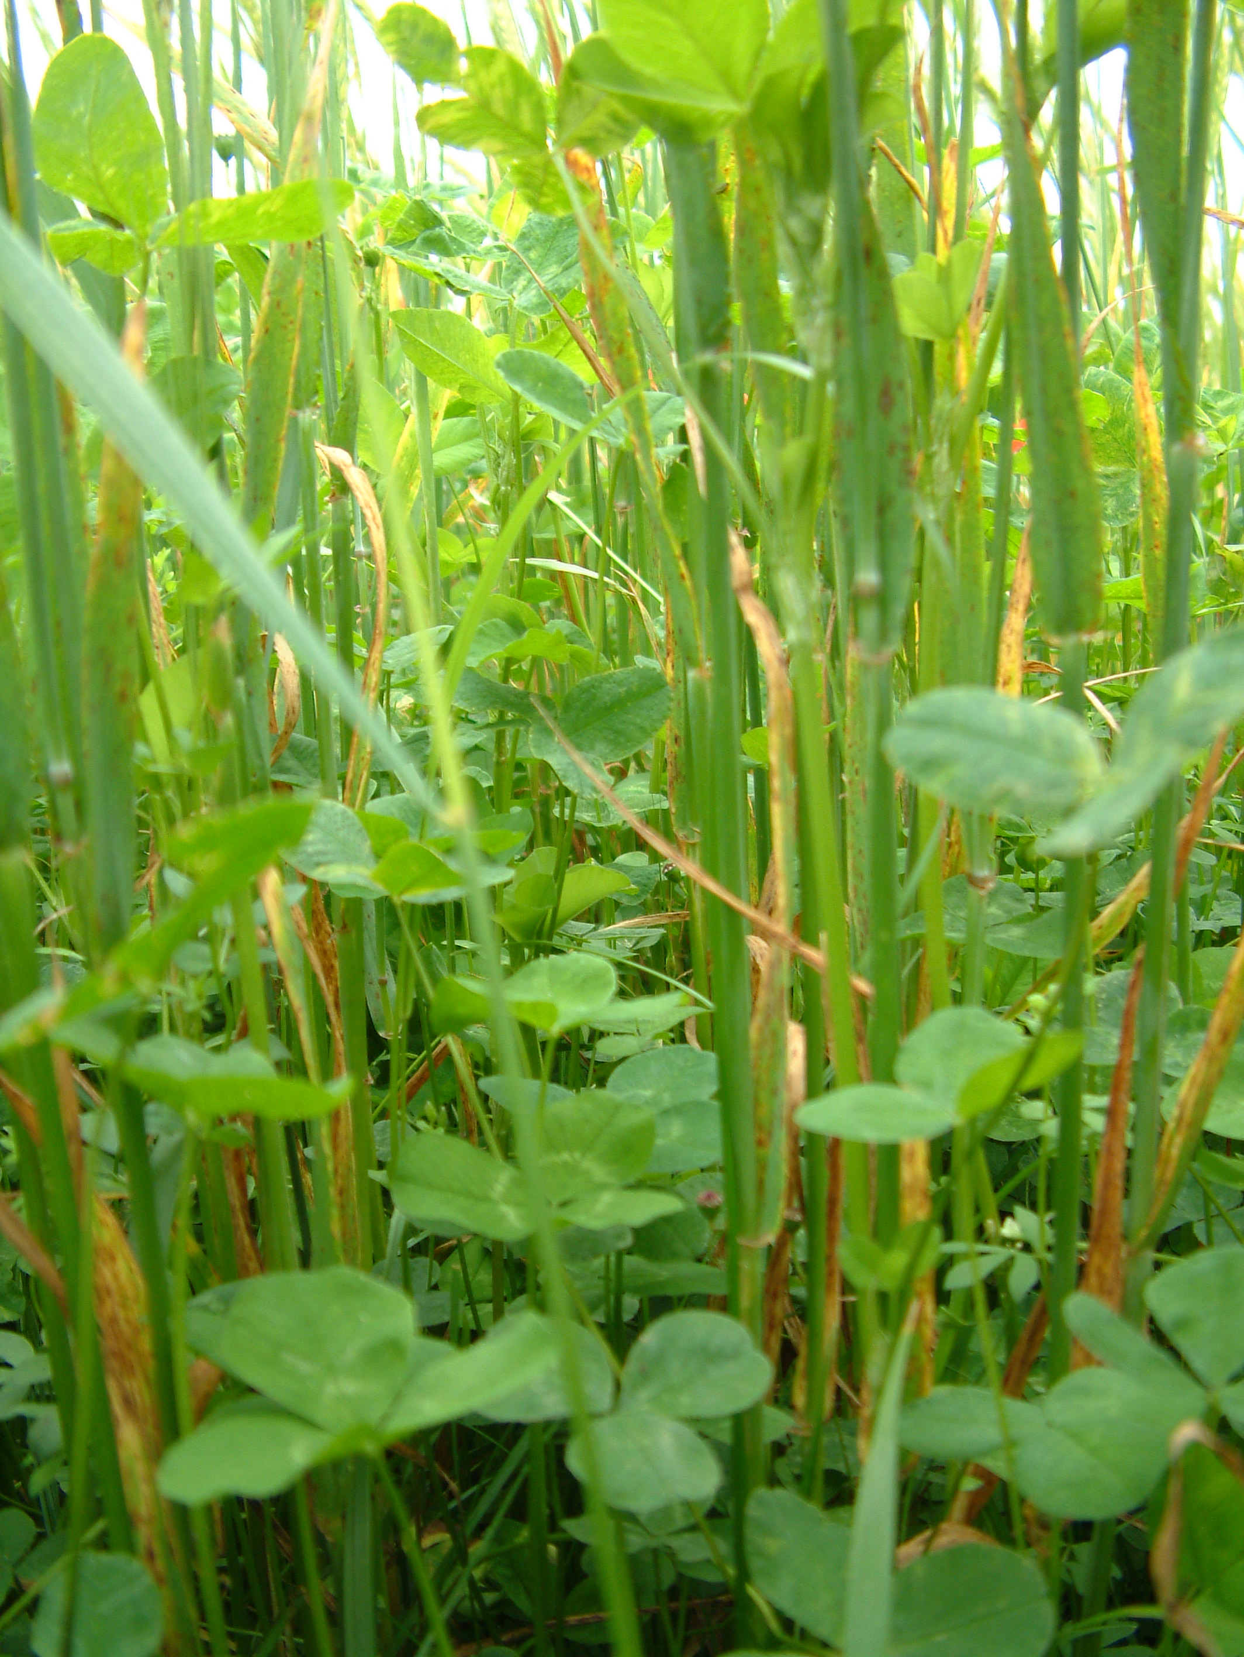
Predlog: Najmanj 20% njivskih površin/leto (npr. kolobarja v 5. letih) v sistemu združenih setev.
(lahko, kot dodatna mera obveznemu kolobarju)
Manj zahtevna skupina - posevki
Združevanje posevkov pravih žit (npr. več sort pšenice, soržica – rž in pšenica,…) , pravih žit in leguminoz (npr. ječmen in grah), združevanje podsevkov detelj in ostalih vrst strnih rastlin (npr. podsev detelje v rani pšenici, ječmenu ali ovsu), združevanje posevkov nepravih žit ali oljnic, združevanje posevkov zelenjavnic,…
Zahtevna skupina - okopavine
Združevanje posevkov okopavin (fižol in koruza), združevanje nasadov vseh vrst zelenjavnic, zelenjavnic in aromatskih rastlin,…)

Slide 8
Biodiverzitetno bogat kolobar – več uporabnih alternativnih rastlin na njivah
Kolobar (vrstenje, kolobarjenje, menjavanje rastlin) je sistem razvrščanja poljščin, krmnih rastlin, aromatskih rastlin in zelenjadnic, ki ga uporabljamo na njivah, vrtovih ali pokritih prostorih. Z njim ustvarjamo kar največjo racionalnost in optimalnost bioloških, organizacijskih in prostorskih vplivov na tla in rastlino. S pravilnim kolobarjem želimo ob primerni tehniki pridelave kar najbolje nadomestiti biološko ravnotežje spontanih fitocenoz. Kolobar ni "recept", ampak naj predstavlja v danih razmerah najboljšo kompromisno rešitev.

Slide 9
Table 1: The list of usable (practically introduced and researched in Slovenia) and economical valuable crops including their inter-crops for increasing functional biodiversity in crop rotation . In: BAVEC, Franc, LISEC, Urška, BAVEC, Martina. Importance of underutilized field crops for increasing functional biodiversity : Chapter 18. V: ŞEN, Bülent (ur.), GRILLO, Oscar (ur.). Selected studies in biodiversity. London, UK: IntechOpen. cop. 2018, str. 377-388
Crops | Inter-crops
Main crops: Maize (Zea mays) Cereals: wheat (Triticum sp.), barley (Hordeum vulgare) , rye (Secale cereale) Potatoes (Solanum tuberosum) Hops (Humulus lupulus) - monoculture Less produced crops: Soybean (Glycine max) Pea (Pisum sativum) Oil (seed) pumpkins Cucurbita pepo group Oil rapeseed (Brasica napus var. napus) Clovers, alfalfa,… Underutilized (minor, neglected, alternative) crops: Horse bean (Faba bean) Beans (Phaseolus sp.), White lupine (Lupinus albus) Buckwheat (Fagopyrum esculentum) Proso millet (Panicum milliaceum) Spelt (Triticum aestivum ssp. spelta) Einkorn (Triticum monococcum) Emmer (Triticum diccocum) Khorosan (Triticum turgidum ssp. turanicum) Camelina (Camelina sativa) Hemp (Canabis sativa) Flax (Linum ussitatissium) Garden poppy (Papaver somniferum ssp. somniferm) Saflower (Charthamus tinctorius), Quina (Chenopodium quinoa) Grain amaranths (Amaranthus sp.) | Maize x climbing bean Cereals x pea Hops x under sown cover crops (Clover, buckwheat, white mustard,…) Pea x cereals, clover x maize, soybean x maize (strip sowing) Clover x under sown cereals Maize x climbing bean Camelina x barley

Slide 10
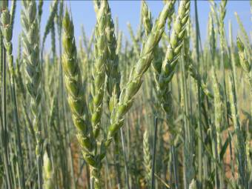
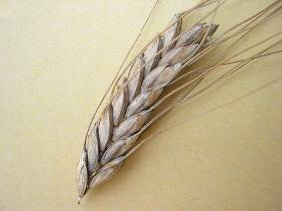
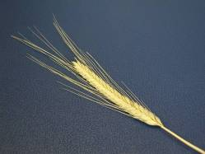
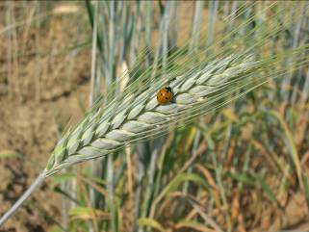
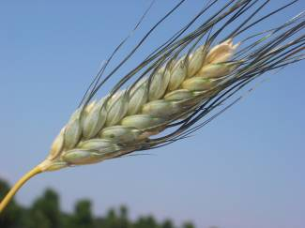
Alternative cereales
Triticum spelta
T. monococcum & T. dicoccon
Triticosecale
Kamut®

Slide 11
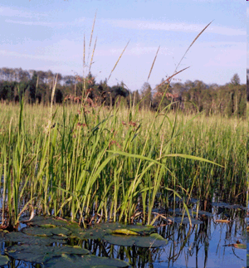
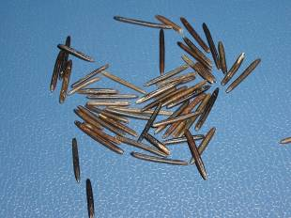
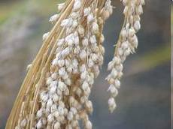
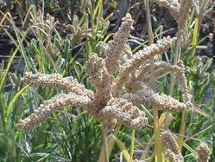
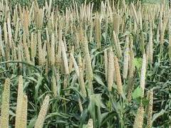
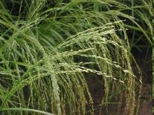
Zizania palustris
Millets

Slide 12
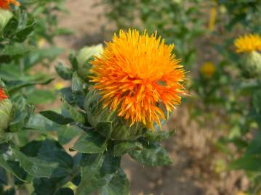
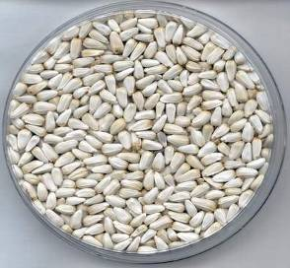
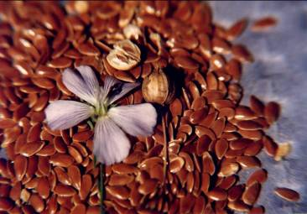
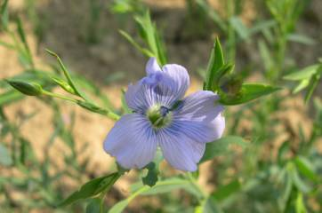
Carthamus tinctorius
Linum usitatissimum

Slide 13
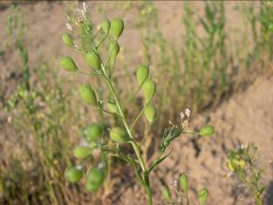
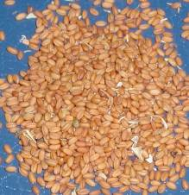
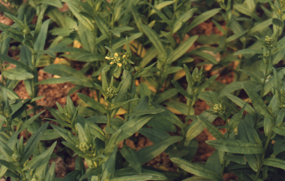
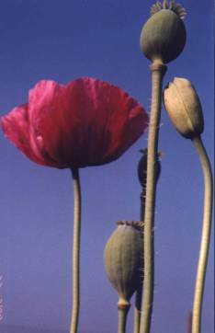
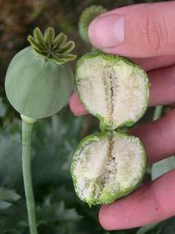
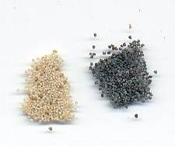
Camelina sativa
Papaver somniferum

Slide 14
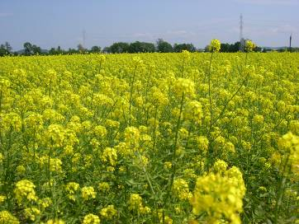
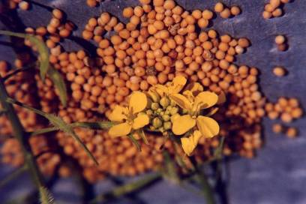
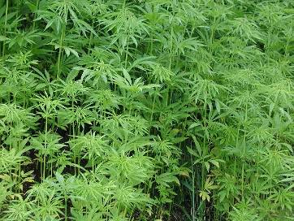
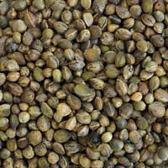
Sinapis alba
Cannabis sativa

Slide 15
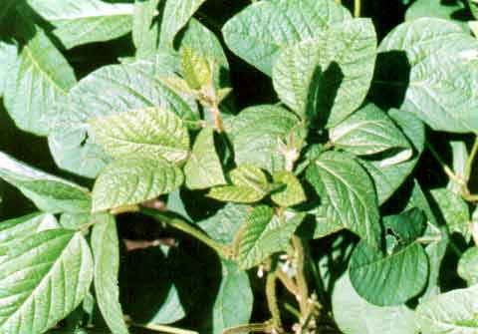
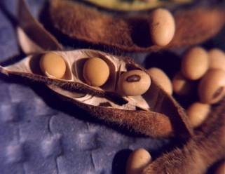
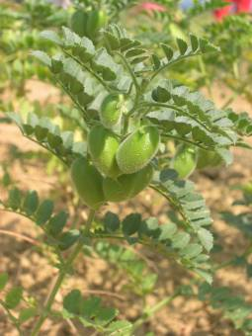
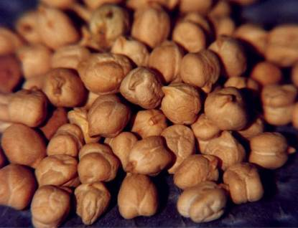
Glycine max
Cicer arietinum

Slide 16
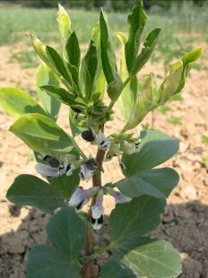
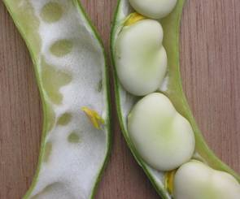
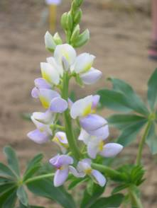
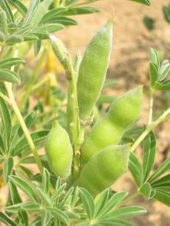
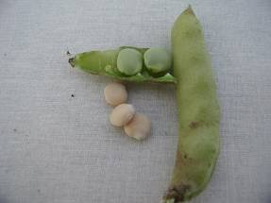
Vicia faba
Lupinus albus

Slide 17
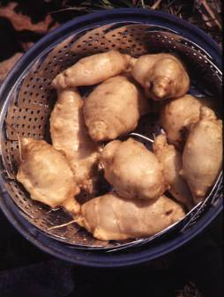
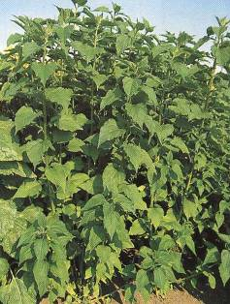
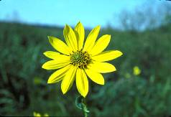
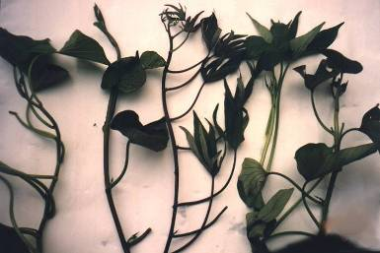
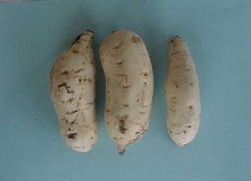
Helianthus tuberosus
Ipomea batatas

Slide 18
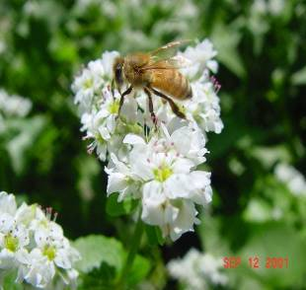
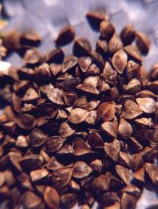
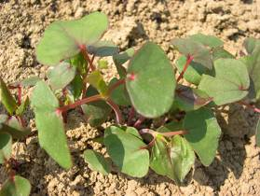
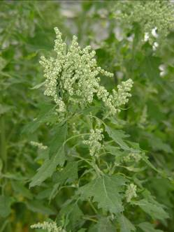


Fagopyrum esculentum
Chenopodium quinoa

Slide 19

Grain amaranths - inflorescence:
1. A. hypochondriacus - erect,
2. A. cruentus - semi erect,
3. A. caudatus - lax, long and dropping of indeterminate growth
4. A. caudatus subsp. mantegazzianus - determinate growth
= club-shaped.

Slide 20






Food from buckwheat: traditional foods, like water boiled žganci and koroški” žganci (like polenta), kačamak in Serbia (polenta + cottage cheese) buckwheat štruklji (rools, buckwheat – cottage chesse pogača (cake) bread from buckewheat + other cereales, buckweat groat, soba noodles,…
Production?
Health food?
Processing?
Marketing?
Gastronomy?

Slide 21



10%AFS
10%AFS
10%AFS

Slide 22
Table 2: SWOT analyses of crop rotations with more underutilized crops on main agronomic, social and economic parameters In: BAVEC, Franc, LISEC, Urška, BAVEC, Martina. Importance of underutilized field crops for increasing functional biodiversity : Chapter 18. V: ŞEN, Bülent (ur.), GRILLO, Oscar (ur.). Selected studies in biodiversity. London, UK: IntechOpen. cop. 2018, str. 377-388
STRENGHTS Rich crop rotation Less plant diseases, pests and weed populations No synthetic chemistry in process No transgenic plants More niche product Nutritional and healthy food Higher prices of products than conventional | WEAKNESSES Loss of genetic materials Not well organized breeding In some cases bad adaptation to environment Lack of whole chain knowledge Lack of knowledge about nutritional and health value of products Less specialized mechanization than in conventional production
OPPORTUNITIES Les risks with sell prices Increasing employment Organize production whole chain (from seed to sell the product) Increasing production of diverse food Development of new tastes by consumers New trading possibilities | THREATS Low yields Unknown products as a food Opposition from intensive sector and multinational corporations

Slide 23
Table 3: SWOT analyses of functional biodiversity of underutilized crops in total agricultural biodiversity. In: BAVEC, Franc, LISEC, Urška, BAVEC, Martina. Importance of underutilized field crops for increasing functional biodiversity : Chapter 18. V: ŞEN, Bülent (ur.), GRILLO, Oscar (ur.). Selected studies in biodiversity. London, UK: IntechOpen. cop. 2018, str. 377-388
STRENGHTS Increasing usable crops in the fields Natural populations of predators and pests, natural regulation of plant diseases and weed populations Increasing pollinator plants Green covered field during longer period More plant rests with different effects on the soil cycles More microorganisms in the soil | WEAKNESSES Bad organized breeding and gene banks exploitation Bad genetic adaptation to growing conditions
OPPORTUNITIES Preservation of honey bees Increasing soil organic matter and available nutrients Symbiotic N fixation with legumes in crop rotation | THREATS Misunderstanding of policy makers about biodiversity benefits for support Use underutilized crops just for genetic modification of plants

Slide 24







Importance of underutilized field crops for increasing functional biodiversity
Franc Bavec*, Urška Lisec, Martina Bavec
All : Faculty of Agriculture and Life Sciences; University of Maribor, Hoče/Maribor, Slovenia
*Corresponding author: franci.bavec@um.si
Abstract: Despite the suggestions to include two or three crops into crop rotation that is widely considered to support the richer biodiversity on fields, industrial field crop production systems are still based mainly on monoculture where the farmers produce permanently mainly one crop. Review and analyses of different possibilities showed that more diverse functional (also important for diverse nutritional and health products of food) biodiversity of underutilized field crops needs to be established, especially if beneficial social and economic effects of introduction underutilized crops into small scale farms are taken into account. We can conclude that functional biodiversity based on rich crop rotations associated with underutilized crops increases biodiversity in the soil and has effect richer and sustainable behaviour of cultural plants with good balance of pests and plant diseases.
Ali je uporabna funkcionalna biodiverziteta
izziv za SKP?

Slide 25
Ajdove jedi: tradicionalni v vodi kuhani in “koroški” žganci, ajdovi štruklji ajdova – skutina pogača kruh s primesjo moke drugih vrst žit ajdova kaša (kot priloga, samostojna jed, za enolončnice, juhe, ….) moderni ‘soba’ rezanci
Biodiverziteta v funkciji !

Slide 26
Predlog: Poleg glavnih poljščin oz. zelenjavnic v kolobarju še uporabne alternativne rastline
(- lahko dodatni ukrep kolobarju)
Najmanj 40% njivskih površin (npr. kolobarja v 5. letih) zasejanih/posajenih z alternativnimi poljščinami ali zelenjavnicami kot glavni ali (in) strniščni posevek).
?**alternativna zelenjavnica: zelenjavnica, ki ne pokriva s pridelavo npr. 60% slovenskih potreb

Slide 27












Welcome to 4th International Symposium on Underutilized Plant Species, Maribor (Slovenia), 18th to 21st June 2019, Convener: F. Bavec
Thank You for attention!

